Slide 1

Gyro Turns
By Sanjay and Arvind Seshan

Slide 2
Lesson Objectives
Learn what Gyro Lag is
Learn one way to correct for this lag
Understand why it is important to explore alternative solutions to a problem
Pre-requisites: My Blocks with Inputs and Outputs, Data wires, Math Blocks, Loops

Slide 3
Gyro Problem 2: Lag
What is lag?
The gyro sensor readings lag behind the true value sometimes
When the turn starts, it takes time for the gyro to begin changing
This lesson presents one way to deal with lag in a turn: reduce the amount of angle that you turn to compensate for lag

Slide 4
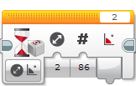
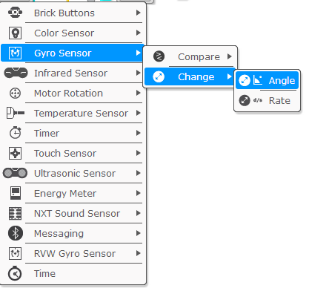
Change Mode in Wait Block
In this lesson we use the Wait Block (gyro sensor) in Change Mode
Advantages over Compare Mode:
You do not need to reset the gyro beforehand
You can measure if the value has changed the target degrees by both decreasing or increasing (no need to change the wait block for a left turn)
Direction (the first input) defines:
0 – check if the value has increased the desired degrees
1 – check if the value has decreased the desired degrees
2 – check if the value has either increased or decreased the desired degrees

Slide 5
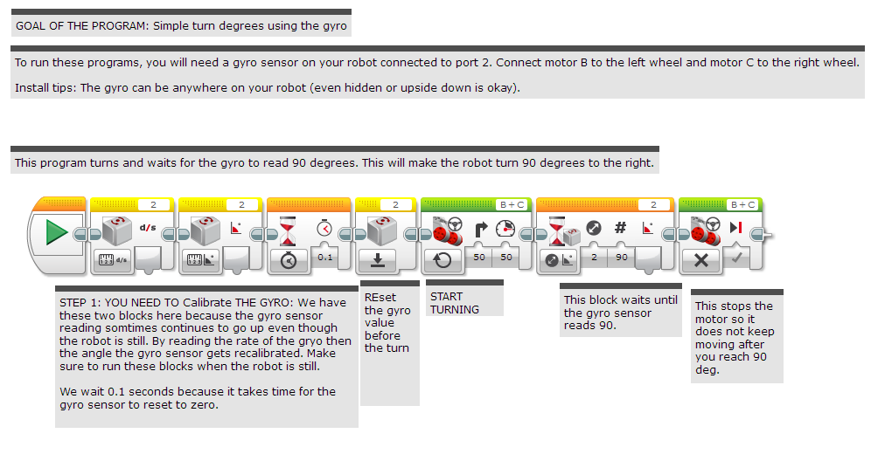
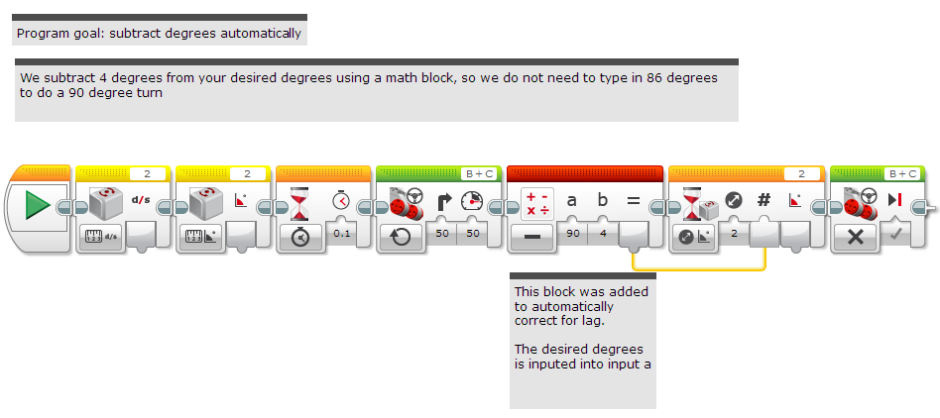
Gyro Turn in Four Easy Steps
STEP 1: Create a simple Gyro Turn program that turns 90 degrees using the Wait for Gyro block in Change Mode
Remember to Calibrate the Gyro before the Wait For Block (see Gyro Lesson for help)
STEP 2: Compensate for Lag
Compensate for the lag by reducing the amount of angle to turn based on your robot (e.g 86 degrees instead of 90 degrees)
Use a Math Block to create an automatic calculator to compensate for lag
STEP 3: Create and Wire the My Block
STEP 4: Repeat the steps to make one for Left Turns vs. one for Right Turns.

Slide 6
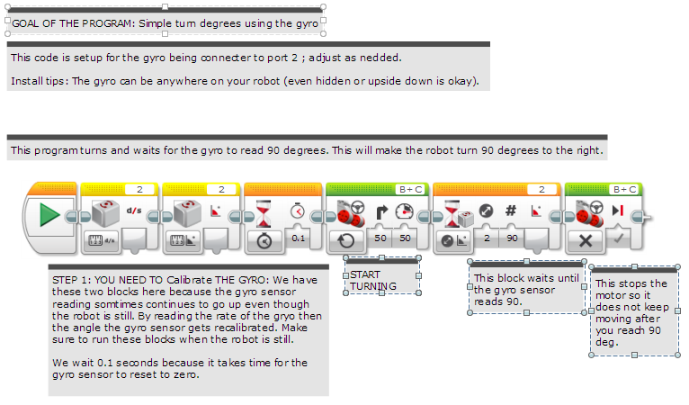
Step 1: Simple Gyro Turn

Slide 7
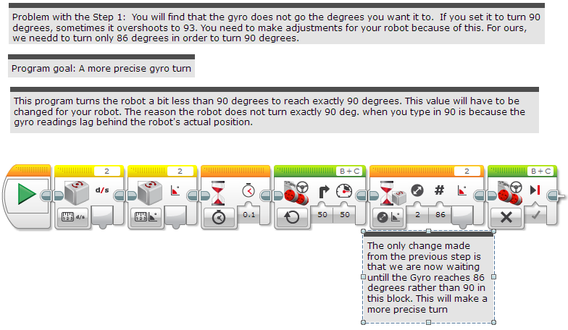
Step 2A: Dealing with Lag

Slide 8
Step 2B: Automatically Correct for Lag

Slide 9
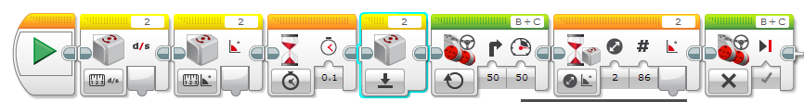
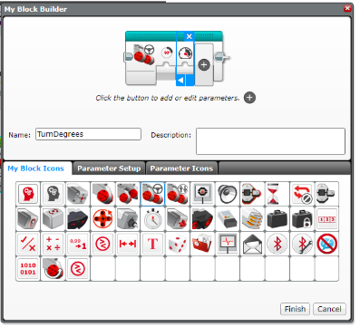
Step 3A: Create a My Block
Highlight all the blocks then go to My Block Builder
Add 2 inputs: one for power and one for and degrees
Refer to the My Blocks with Inputs & Outputs lesson if you need help setting up the My Block
A
B

Slide 10
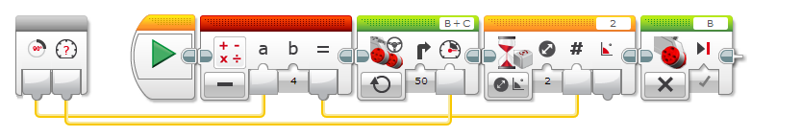
Stage 3B: Wire the My Block
degrees
power
Connect the degrees value into the math block and the power into the move steering block

Slide 11
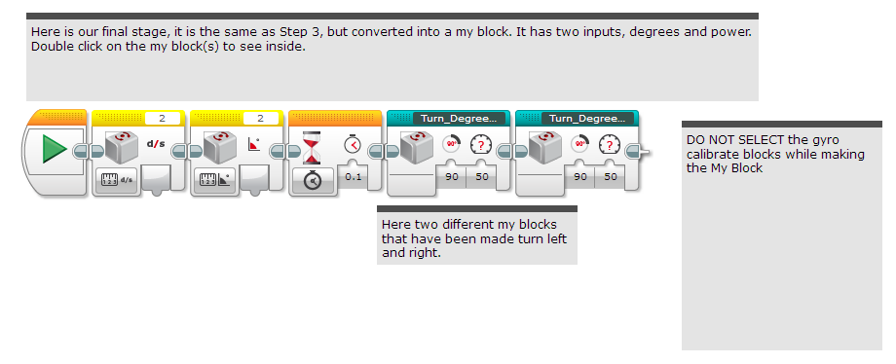
Stage 4: Using the My Block

Slide 12
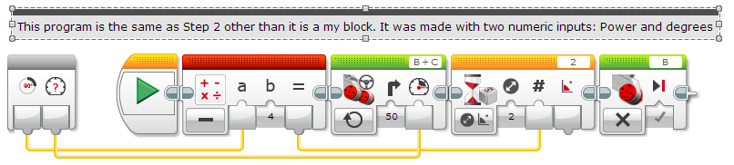
Step 4: Turn Degrees Right

Slide 13
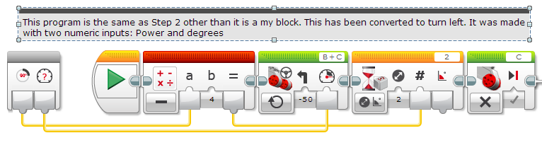
Step 4: Turn Degrees Left

Slide 14
Discussion
What is gyro lag?
Ans. The gyro sensor’s reading lags behind the true reading
What is one way to compensate for lag?
Ans: Reduce the number of degrees that you turn

Slide 15
Credits
This tutorial was written by Sanjay Seshan and Arvind Seshan
More lessons at www.ev3lessons.com
This work is licensed under a Creative Commons Attribution-NonCommercial-ShareAlike 4.0 International License.

